Slide 1
HIERARCHICAL CLUSTERING

Slide 2
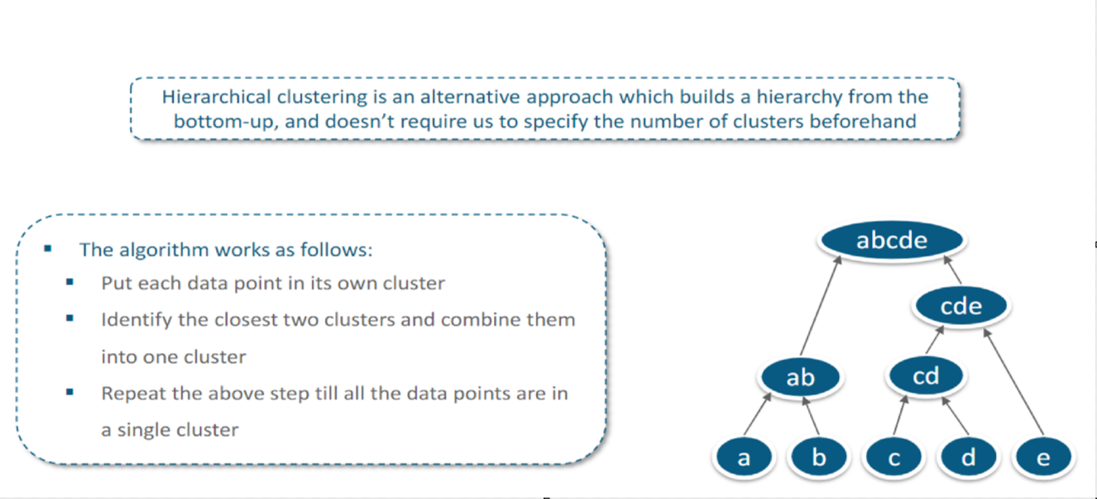
Hierarchical Clustering

Slide 3
Hierarchical Clustering
Hierarchical Clustering Methods predict subgroups within a data by:
Finding the distance between each data point and its nearest neighbours.
Linking most nearby neighbours.

Slide 4
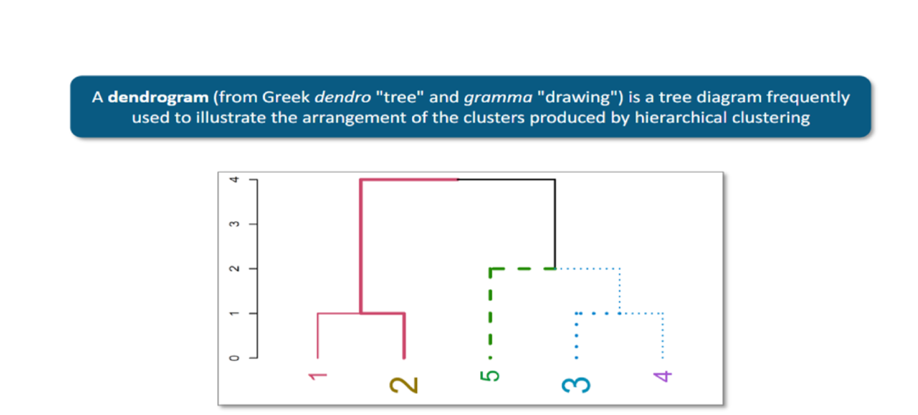
Dendrogram

Slide 5
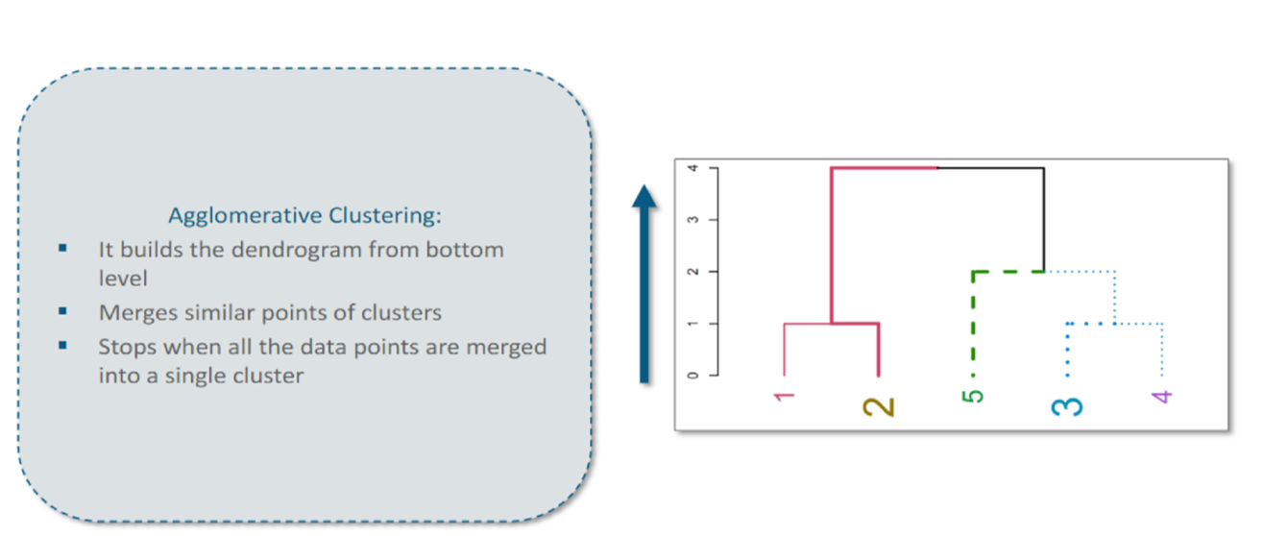
Agglomerative Clustering

Slide 6
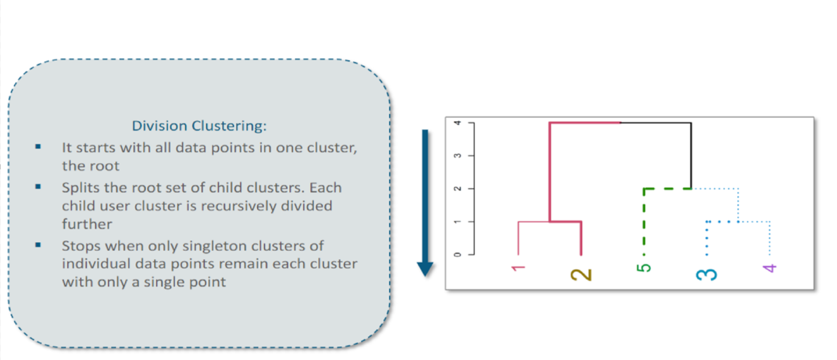
Division Clustering

Slide 7
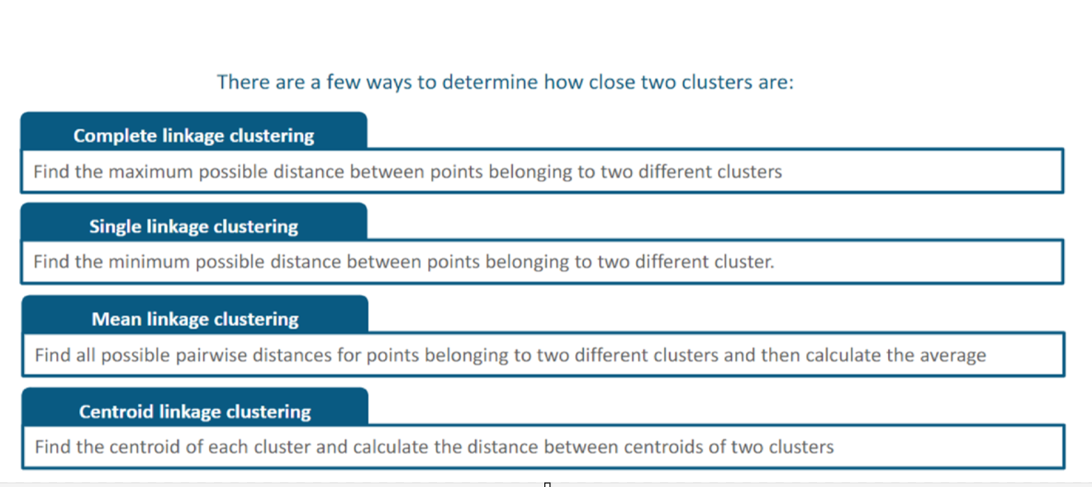
Distance Measures

Slide 8
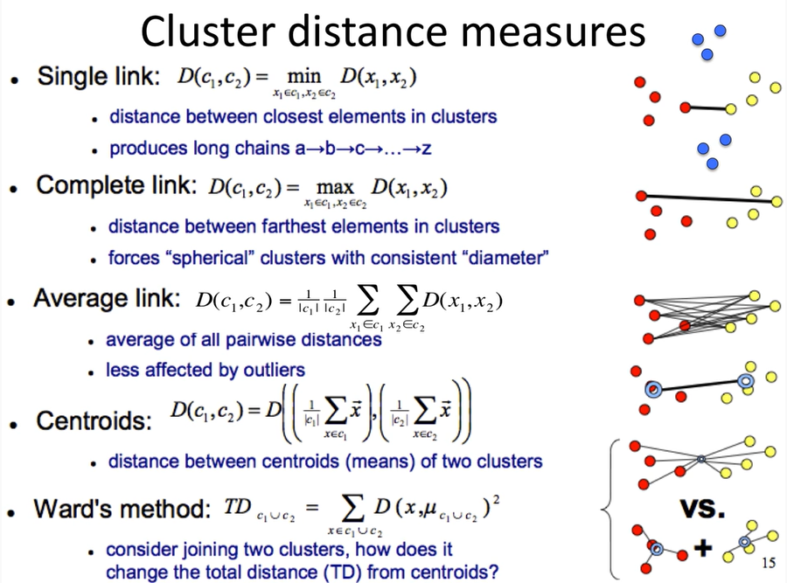

Slide 9
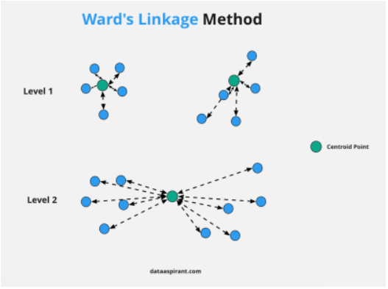
Ward Method
It is a two-step process
Find the WCSS for each cluster
Merge the clusters and find WCSS
Ward’s method says that the distance between two clusters, A and B, is how much the sum of squares (WCSS) will increase when we merge them

Slide 10
Hierarchical Clustering Parameters
Distance Metrics
Euclidian
Manhattan
Cosine
Linkage Parameters
Ward
Completer
Average
Single

Slide 11
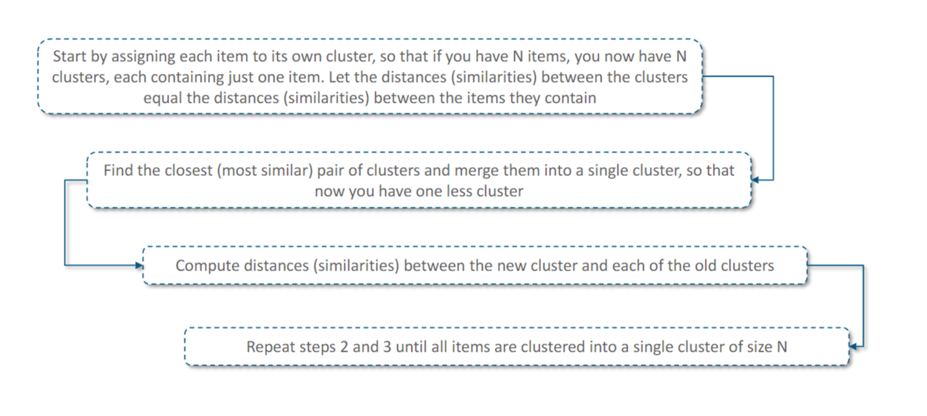
Hierarchical Clustering Steps

Slide 12
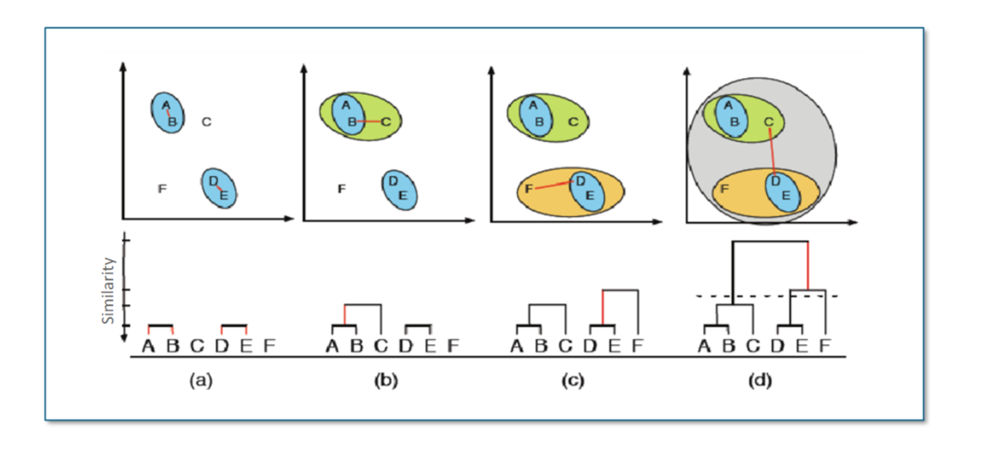
Hierarchical Clustering-Example

Slide 13
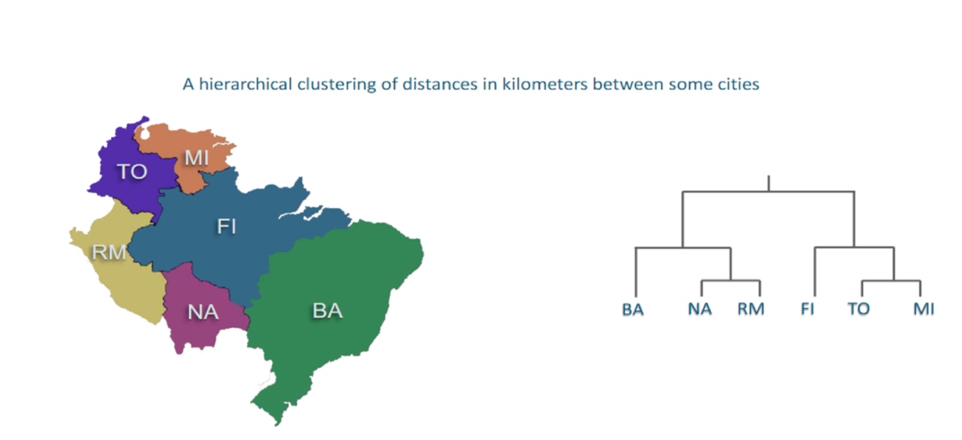
Hierarchical Clustering-Example

Slide 14
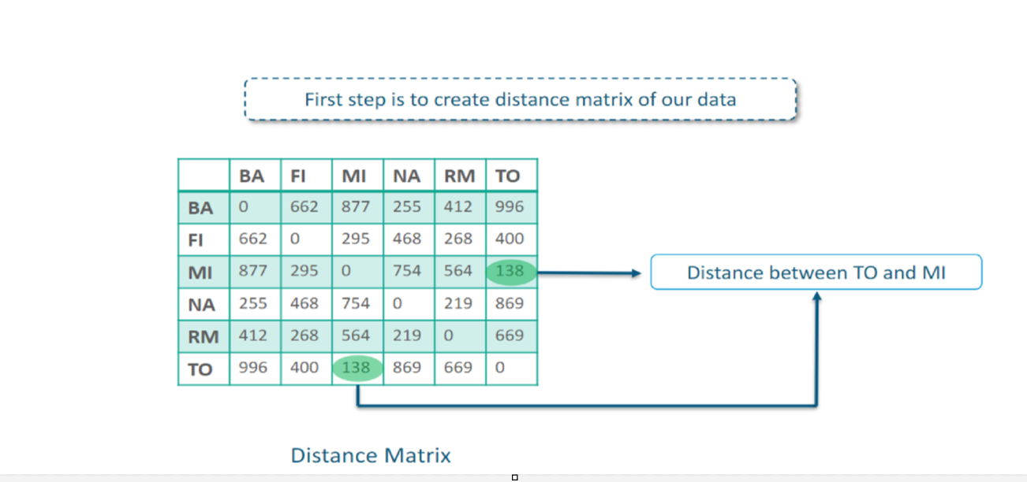
Example- Step 1

Slide 15
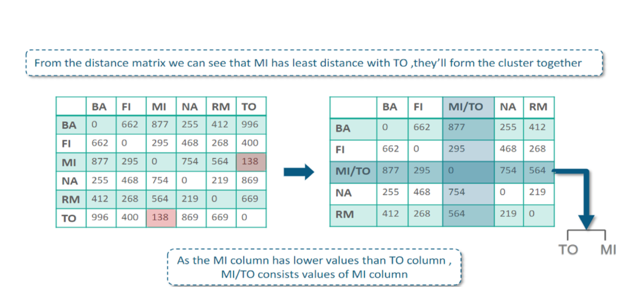
Example- Step 2

Slide 16
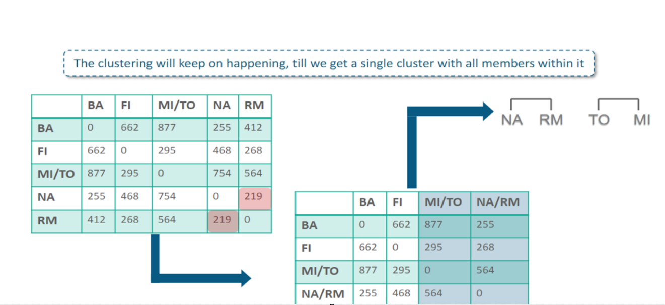
Example- Step 3

Slide 17
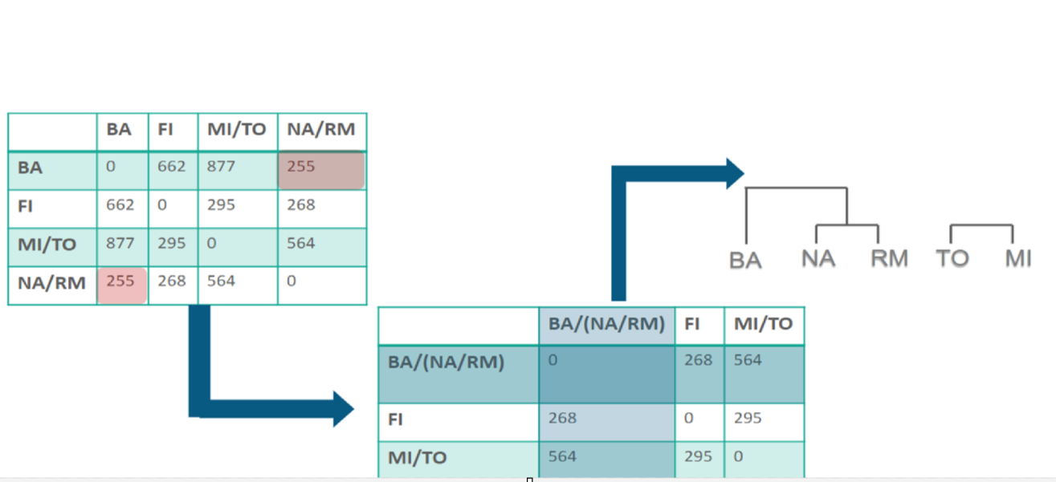
Example- Step 4

Slide 18
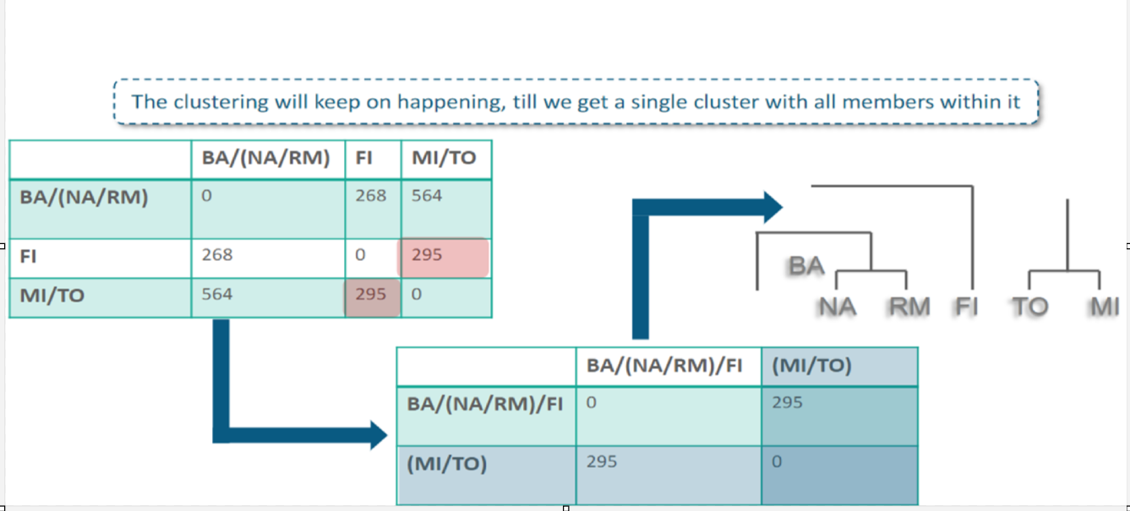
Example- Step 5

Slide 19
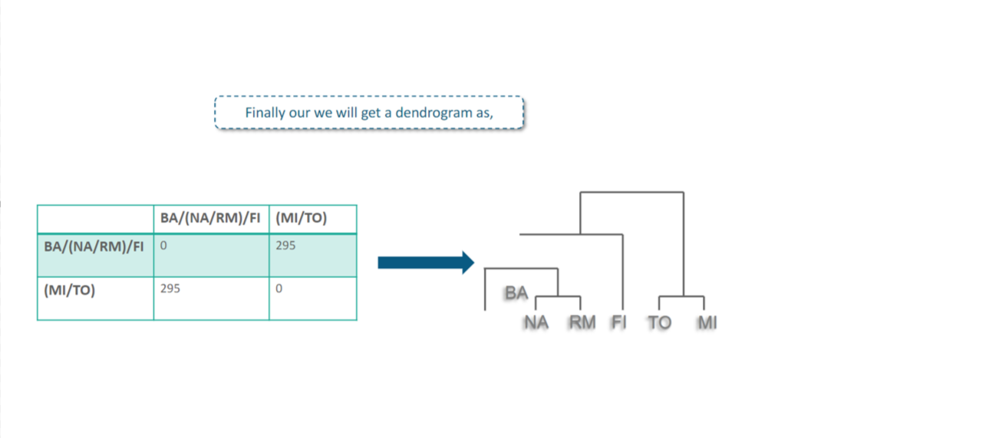
Example- Step 6

Slide 20
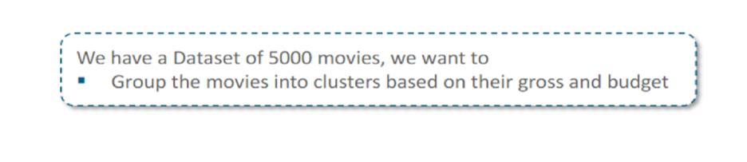
Hierarchical Clustering- Example

Slide 21
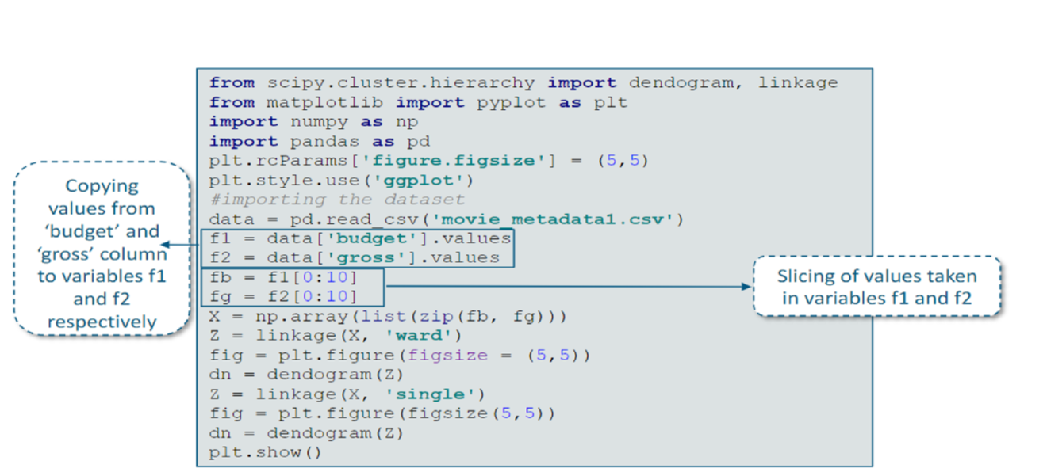
Hierarchical Clustering- Solution

Slide 22
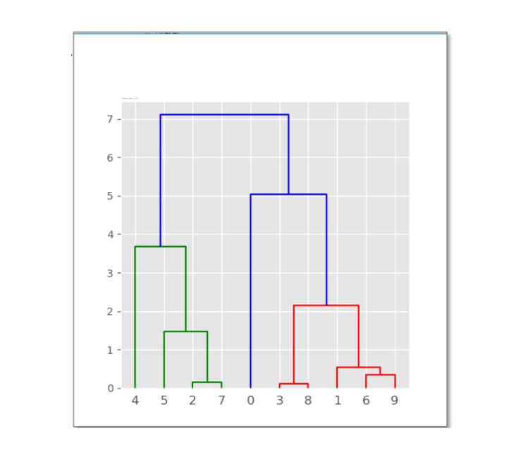
Solution- Dendrogram with Ward

Slide 23
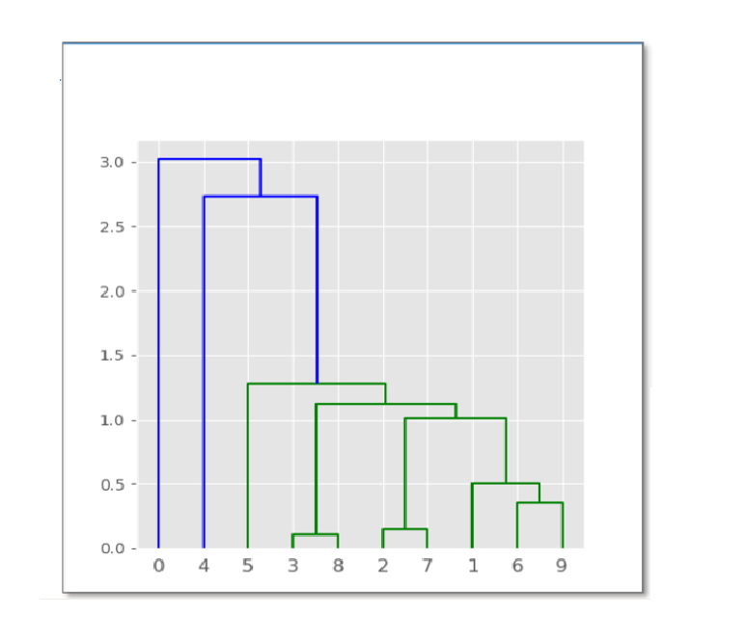
Solution- Dendrogram with Single

Slide 24
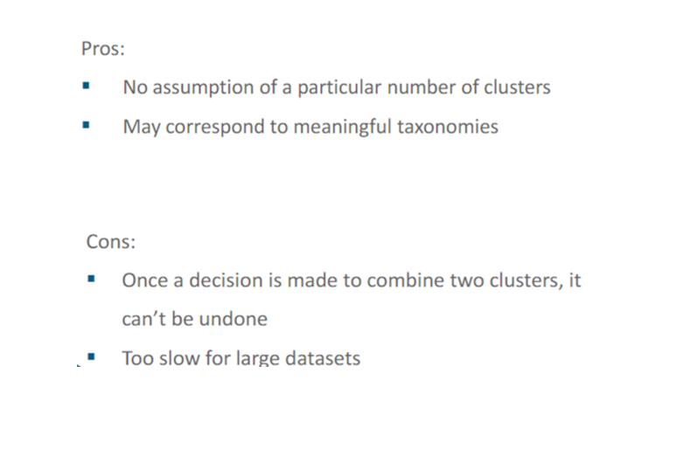
Hierarchical Clustering

Slide 25
